Slide 1
Loyola University Chicago
FACHEX and Tuition Exchange Programs

Slide 2
Important
The following information is specific to EXTERNAL students (eligible dependents of faculty/staff employed at another participating institution – the ‘Export’ institution).
Loyola University Chicago (LUC) participates in both the FACHEX and TEP programs.
For this purpose, LUC is considered the host institution or ‘Import’ institution.
Current LUC faculty/staff should view the information guide posted on our website.

Slide 3
FACHEX
Established by Association of Jesuit Colleges and Universities (AJCU) in 1971
FACHEX is an acronym for Faculty and Staff Children Exchange.
Twenty-six Jesuit universities participate in the FACHEX program (Georgetown University is the only AJCU school not participating).

Slide 4
Tuition exchange program (TEP)
TEP is a reciprocal scholarship opportunity for the dependents of eligible faculty and staff at all Tuition Exchange member schools.
Membership currently includes more than 670 institutions, ranging in size from 250 to 50,000 students and representing 47 U.S. states, the District of Columbia, and several other countries.

Slide 5
Application process overview
The student should follow their ‘Export’ institutions process and guidelines for completing the TE EZ-Application.
The account and application are for BOTH FACHEX and TE. The student does not need to create one for each program.
The TE EZ-Application is for scholarship consideration at LUC.
The deadline to submit the TE EZ-Application to LUC is December 1, 2026

Slide 6
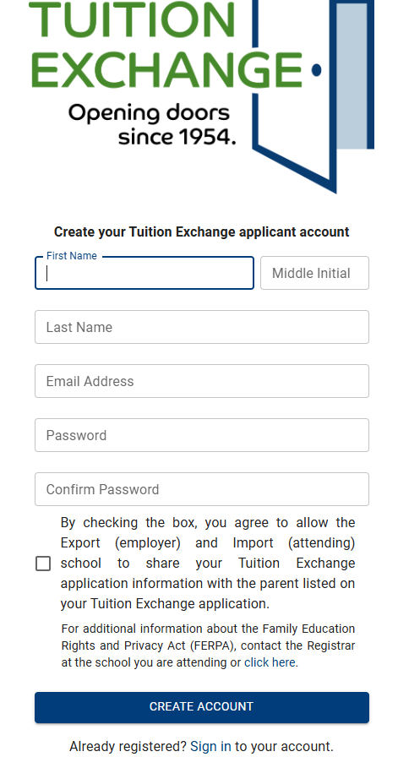
Application process: Step 1
Create a TE account at Tuition Exchange
The TE Account is all about the student. Do NOT create an account as the employee
The student should have an email account besides their high school email address

Slide 7

Application process: Step 2
Have the student log in to their account to complete the EZ-Application: Tuition Exchange

Slide 8
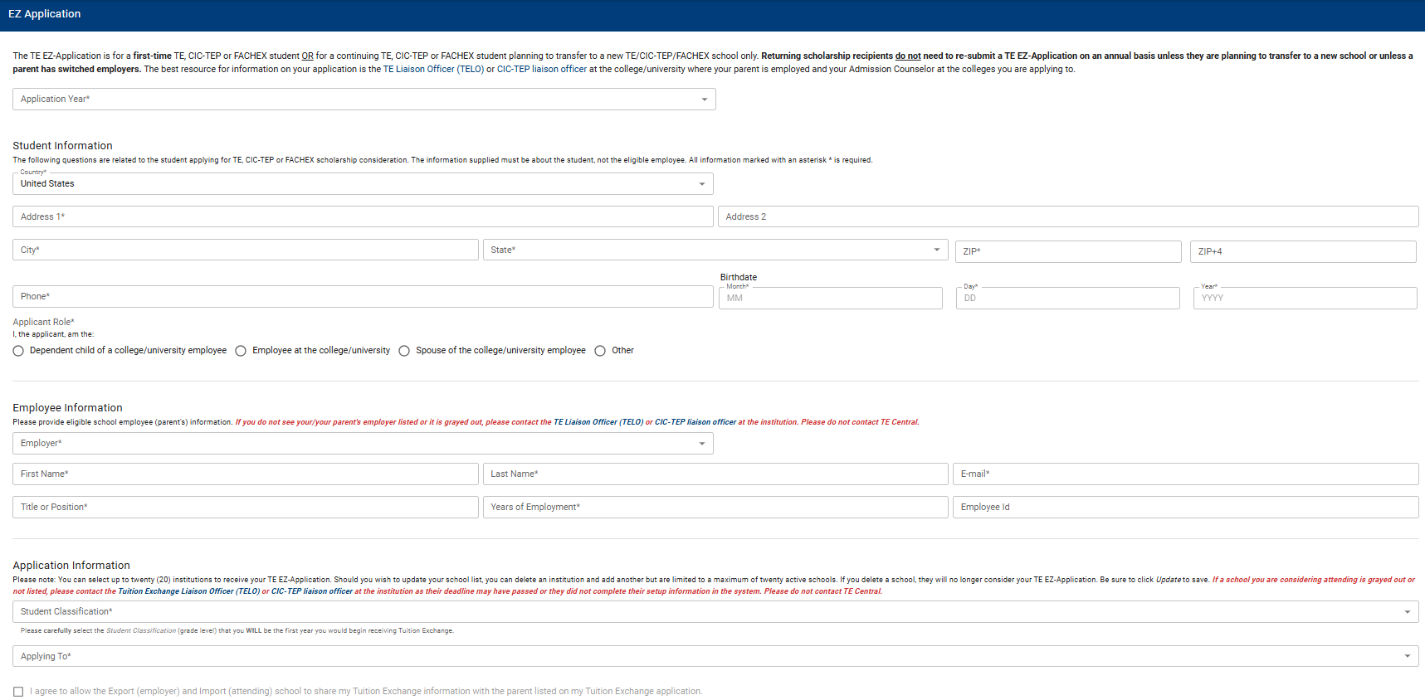
EZ-application
Select the 2027-2028 Academic Year
The Student must complete each field
The Student much select ‘Dependent of a college/university employee’
Complete all fields with the employee’s information
Select the institutions the student is interested in applying for FACHEX/TE

Slide 9
What Happens when the student submits their te EZ-application?
Once the TE EZ-Application is completed and submitted, it will be sent to the TE liaison at your institution (Export) for review and approval.
Once the EZ-Application is approved by your TE liaison, an email will automatically be generated LUC (Import) and any other selected institution listed on the application.

Slide 10
Commonly Asked questions

Slide 11
Does luc have a fachex/te application deadline?
Yes!
LUC must receive the TE application by December 1, 2026

Slide 12
Does the student need to be admitted by December 1, 2026 to be considered for FACHEX/TE?
No! But…
The student must have applied to LUC AND have their FACHEX/TE application completed by December 1, 2026.

Slide 13
When will award decisions be made?
We anticipate having initial awards made no later than the middle of January.
The student and employee are notified via email.

Slide 14
What criteria does LUC consider when awarding FACHEX/TEP?
LUC does a complete review of the student’s admissions application and considers High School GPA, test scores (if reported), number of AP or honors courses, and dual-credit taken.
Given our Jesuit mission, we also consider extra curricular activities such as community engagement/service, work/employment, athletics, clubs, and other activities that align with our mission.
Academics are important, but they are not everything. We strive to take a holistic approach to reviewing each application.

Slide 15
Selection and availability of awards
These are highly competitive awards and there are no guarantees that your dependent will be selected to receive FACHEX and/or TEP.
LUC will prioritizes award selections to first-semester freshman students, and if spots remain, will consider transfer and currently enrolled LUC students.
LUC receives approximately 500 FACHEX/TEP applications each year and we award between 10-15 scholarships annually between FACHEX and TEP.

Slide 16
Do I need to complete the FAFSA?
No.
LUC does not require the completion of the FAFSA for award consideration.

Slide 17
How much does the FACHEX award cover?
If granted, the student receives a tuition award that covers 90% of tuition only. The student is responsible for the remaining 10% of tuition, plus any fees, and/or housing and meal costs. Any additional expenses incurred by the student such as travel related expenses, or books are the sole responsibility of the student and/or the student's family.
If granted, the award is provided for 4 years of continuous full-time undergraduate study during the traditional fall and spring semesters. It is not available for part-time study, graduate or professional degree programs.
FACHEX is also available for j-term and summer sessions.
If you have previously been awarded a merit scholarship and/or other institutional aid (IE. Loyola Grant, Director’s Award, Heritage Award, etc.) and are then given the FACHEX scholarship, the previously awarded institutional scholarship(s)/grant(s) will become honorary and cannot be used to cover the remaining tuition, fees, housing, meals, or other direct or in-direct expenses.
FACHEX cannot be combined with other institutional departmental awards.

Slide 18
How much does the TEP award cover?
For the 2027-2028 academic year, if granted, the student receives a tuition award that covers $45,000 of tuition only. The student is responsible for the remainder of tuition, plus any fees, and/or room and board costs. Any additional expenses incurred by the student such as travel related expenses, or books are the sole responsibility of the student and/or the student's family.
If granted, the award is provided for 4 years of continuous full-time undergraduate study during the traditional fall and spring semesters. It is not available for part-time study, graduate or professional degree programs.
TEP does not cover j-term or summer sessions.
If you have previously been awarded a merit scholarship and/or other institutional aid (IE. Loyola Grant, Director’s Award, Heritage Award, etc.) and are then given the TE scholarship, the previously awarded institutional scholarship(s)/grant(s) will become honorary and cannot be used to cover the remaining tuition, fees, housing, meals, or other direct or in-direct expenses.
With the approval of the FACHEX/TEP liaison, TEP may be combined with other departmental awards but cannot exceed 90% of tuition. TEP is restricted to tuition only and other departmental awards cannot be used to cover the remaining tuition, fees, housing, meals, or other director or in-direct expenses.

Slide 19
What happens if I do not receive a FACHEX/TEP award offer?
LUC keeps an automatic waitlist and you will be considered for a FACHEX/TEP award should an opening occur.
If a student wishes to withdrawal their application from Loyola, the student will be removed from the waitlist and will not be considered for FACHEX/TEP should an opening occur.
Students are not required to accept/decline the FACHEX/TEP awards until the May 1 deposit deadline. We strongly encourage students to confirm their acceptance and make their deposit or decline the FACHEX/TEP award prior to the May 1 deposit deadline so LUC can offer awards to other eligible students from the waitlist.
After May 1, if an offer was made to a student who did not deposit, the FACHEX/TEP offer will be rescinded and offered to an eligible student from the waitlist who did make an enrollment deposit.

Slide 20
Additional Information
Student are encourage to review our FACHEX/TEP website for additional information and policies.

Slide 21
Who is Loyola’s FACHEX/TEP Liaison?
LUC's FACHEX and Tuition Exchange liaison officer is Tobyn Friar, Assistant Vice President.
All questions about these programs can be directed to his attention by emailing at tfriar@luc.edu.

